Slide 1
SOFTWARE ARCHITECTURE & DESIGN

Slide 2

Software Architectural Styles
and
Architectural & Design Patterns

Slide 3
Combined View of Architectural Styles, Patterns and Design Patterns
deep
some combine
these into “styles”
Architectural
patterns
Knowledge level of the problem domain
Architectural
Styles
Design
patterns
mostly for OO detail design & programming
shallow
programming
level
software design
component
level
Software System
level
Where are these applicable

Slide 4
Architectural Styles

Slide 5

Architectural Styles
Can you identify this picture
Notes:
Hampi - Vijayanagar

Slide 6

Architectural Styles
Can you identify this picture
Notes:
Roman – Colosseum- Architecture – Round buildings stone pillars ..archs ..

Slide 7
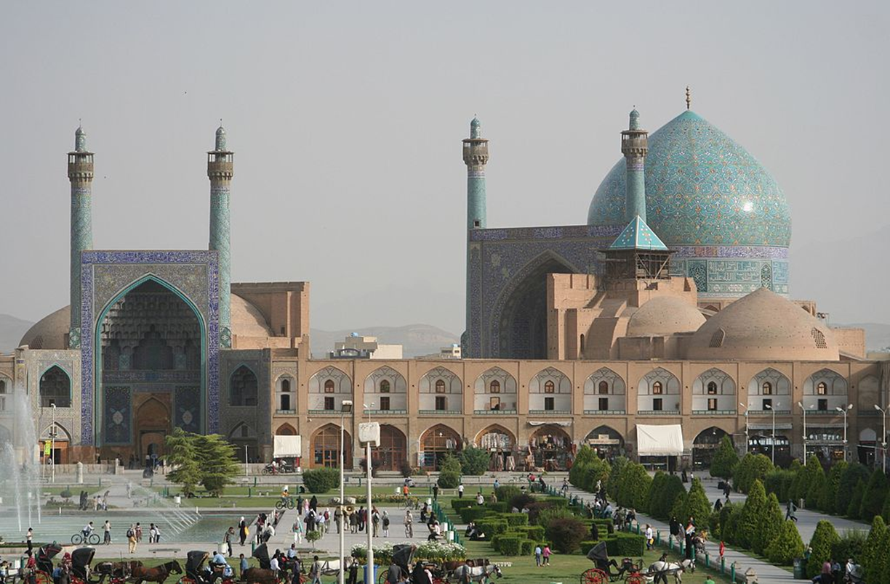
Architectural Styles
Can you identify this picture
Notes:
Persian Architecture – Symmetry, Domes

Slide 8

Architectural Styles
Can you identify this picture
Notes:
Italian – Neo-Classical Architecture

Slide 9

Architectural Styles
Can you identify this picture
Notes:
Gothic Architecture

Slide 10

Architectural Styles
Architecture from Hampi
and Vijayanagar
Neo Classical Architecture
Roman Architecture
Persian Islamic Architecture
Gothic Architecture

Slide 11
Architectural Styles
Architectural style is a pattern of organization of the components in an architecture, characterized by the features that make it notable.
It can be looked at as a tool box containing tools of architecture (common patterns of software organization or recurrent structure) which could be used in constructing software modules
It addresses the structure and behavior of the system
It’s a way of organizing modules (contrary to a pattern, it doesn't exist to "solve" a problem) Eg. Pipe & filter, Client/server, Main program & subroutine, Abstract Data Types / OO

Slide 12
Architectural Styles
It provides
Vocabulary: A set of design elements such as pipes, filters, client, severs, parsers, databases, etc.
Design rules: These are the set of constraints that dictates how the processing elements would be connected.
Semantic interpretation: It provides a well-defined meaning of the connected design elements.
Analysis: Many styles provide analyses that can be performed on systems build in that style, i.e., deadlock detection, scheduling, etc.
This could be generically looked at as Components and Connectors

Slide 13
Architectural Styles
There are many recognized architectural styles like:
main program with subroutines
implicit invocation
pipes and filters
repository (blackboard)
layers of abstraction
Client Server (Can be looked at as a Style as well as a pattern)
Component Based System
Service Oriented Architecture
Object Oriented Architecture

Slide 14
Architectural Styles : Main-program-with-subroutines
Generic: Traditional Language-Influenced Style
Problem: System is described as a hierarchy of functions; This is the natural outcome of the functional decomposition of the system. The top level module acts as a main program and invokes the other modules in the right order. Usually a single thread of control
Context: Language with nested procedures
Solution:
System model: Procedures and modules are defined in a hierarchy. Higher level module calls lower level modules. Hierarchy may be strict (n can only call n-1) or weak (where n can call n-i) may be weak or strong, coupling/cohesion arguments
Components: Procedures which can be viewed as residing in the main program, and have their own local and global data
Connectors: procedure call and shared access to global data
Control structure: single centralized thread of control: main program pulls the strings

Slide 15
Architectural & Design Patterns

Slide 16
Architectural & Design Patterns
Are well known or proven approaches (or a solutions to an architectural or design problem) of structuring, functioning and solutioning of the subsystems which has been used earlier and is know to work for the problem scenario
It’s a potential solution to a recurring problem and is a good starting point
It’s a named collection of architectural decisions or design approaches which has resulted in a successful solution
These "solve" a problem E.g. MVC solves the problem of separating the UI from the rest
These factor in the properties expected of architectures or design and supports with description for the same.
Architectural pattern could be looked at from the perspective of number of layers between the user and the data as in being Tiered or Client Server etc. and Design patterns can be looked at to be procedural or object-oriented

Slide 17
Architectural Pattern : Tiered Architecture : Single tiered
Monolithic or Single tiered architecture : It consists of a single application layer that supports the user interface, the business rules, and the manipulation of the data all in one
Example : Microsoft Word is an example of a monolithic application. The user interface is an integral part of the application. The business rules, such as how to paginate and hyphenate, are also part of the application. The file access routines, to manipulate the data of the document, are also part of the application
Usage : This is widely used in client server application

Slide 18
Architectural Pattern : Tiered Architecture : Two tiered architecture
The business rules and user interface remain as part of the client application. The data retrieval and manipulation is performed by another separate application, usually found on a physically separate system or User interface remains separate and the business rules are executed on the data storage system. A client application can explicitly call a stored procedure, which would then be run on the server. A trigger can also execute a stored procedure, which is the occurrence of a specific event in the data.
Example: An application could be something like SQL Server or Oracle, which is functioning as a data storage device for the application.
Usage: This type of application is widely used in the traditional client-server types of applications.

Slide 19
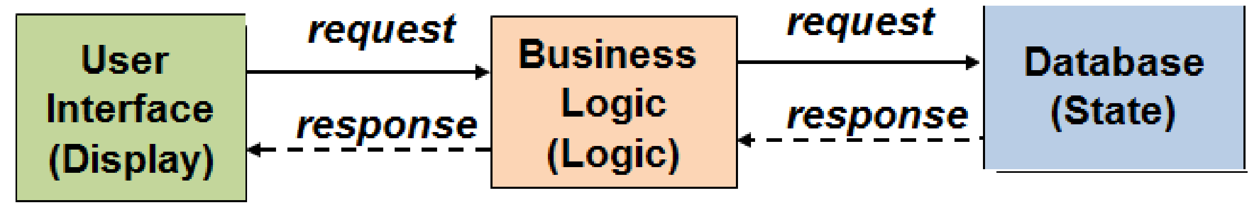
Architectural Pattern : Tiered Architecture : Three tiered architecture (State-Logic-Display)
State-Logic-Display is a three tier architectural pattern where
The client (user interface), business layer and the database are separated
The clients access business functionalities through a user “display.”
The business functionalities are provided through the “logic” part
The data store keeps all the persistent data or “states,” usually in a DB
In this pattern, the client would never access the data storage directly
Usage:
This type of system allows for any part of the system to be modified without having to change the other two parts.

Slide 20
Architectural Pattern : Client Server Pattern
Generic : The client/server architectural pattern describes distributed systems that involve a separate client and server system, and a connecting network. This could be looked at as a two tier architecture too
Client - A client is a single-user workstation that provides presentation services and the appropriate computing, connectivity and the database services and the interfaces relevant to the business need
Server- A server is one or more multi-user processors, with shared memory providing, computing, connectivity and the database services and the interfaces relevant to the business needs

Slide 21
Design Pattern : Procedural Patterns
These design patterns could be procedural or object oriented.
Procedural patterns are common solutions for analyzing a problem prior to & during construction.
Structural decomposition pattern | Breaks down a large system into subsystems and complex components into co-operating parts, such as a product breakdown structure
Organization of work pattern | defines how components work together to solve a problem, such as master-slave and peer-to-peer
Access control pattern | describes how access to services and components is controlled, such as through a proxy
Management pattern | defines how to handle homogeneous collections in their entirety, such as a command processor and view handler
Communication pattern | defines how to organize communication among components, such as a forwarder-receiver, dispatcher-server, and publisher-subscriber

Slide 22
Design Pattern: Objected Oriented Pattern
These are common, reusable solutions to object-oriented programming problems. Some of these are also called Gang of Four (GOF) patterns :
Creational patterns that focus on the creation of objects
E.g. Singleton, Builder, Factory …
Structural patterns that deal with the composition of objects
E.g. Adapter, Bride, Façade, Proxy …
Behavioural patterns that describe how objects interact
E.g. Command, Interpreter, Iterator
Distribution patterns that deal with interfaces for distributed systems
E.g. Class Stubs and skeletons
Notes:
Singleton : Ensures there is only one instance and provides a global point of access
Builder: Separates the construction of a complex object from its representation allowing the same construction process to create various representations
Factory: defines an interface for creating an object but lets subclasses decide which class to instantiate,. Factory method lets the class defer instantiation to sub classes
Adapter: Converts the interface of a class into another interface which the clients expect. This lets incompatible interface components to work together.
Bridge: Decouples an abstraction from its implementation allowing the two to vary independently
Façade: Provides a unified interface to a set of interfaces in a subsystem. Provides higher level interfaces which are easier to use
Proxy: Provides a placeholder for another object to control access to it.

Slide 23
Singleton Pattern
ClientObj A
ClientObj B
ClientObj C
Intent
Ensures that only one instance of a class is created.
Provide a global point of access to the object
Motivation
This is useful when only one object is needed to coordinate actions across the system
It involves only one class which is responsible to instantiate itself
To make sure it creates not more than one instance; in the same time it provides a global point of access to that instance.
In this case the same instance can be used from everywhere, being impossible to invoke directly the constructor each time.
Example
Centralized management of global resources
Examples: Logger classes, configuration classes, Print Spooler, Window Manager, Database Connection Manager
Singleton Object
Task
Notes:
Singleton : Ensures there is only one instance and provides a global point of access
Builder: Separates the construction of a complex object from its representation allowing the same construction process to create various representations
Factory: defines an interface for creating an object but lets subclasses decide which class to instantiate,. Factory method lets class defer instantiation to sub classes

Slide 24
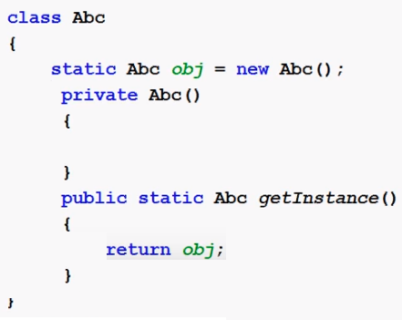
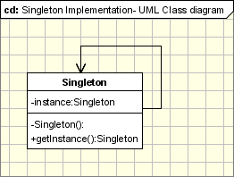
Singleton Pattern
The implementation involves a static member in the "Singleton" class, a private constructor and a static public method that returns a reference to the static member
The Singleton Pattern defines a getInstance operation which exposes the unique instance which is accessed by the clients. getInstance() is responsible for creating its class unique instance in case it is not created yet and to return that instance
Notes:
Singleton : Ensures there is only one instance and provides a global point of access
Builder: Separates the construction of a complex object from its representation allowing the same construction process to create various representations
Factory: defines an interface for creating an object but lets subclasses decide which class to instantiate,. Factory method lets class defer instantiation to sub classes

Slide 25
Anti Pattern
Patterns describe desirable behavior and Antipatterns describe situations one had better avoid
In agile approaches (XP), refactoring is applied whenever an antipattern has been introduced
Eg.
God class: class that holds most responsibilities
Lava flow: dead code which gets carried forward indefinitely
..
Notes:
Singleton : Ensures there is only one instance and provides a global point of access
Builder: Separates the construction of a complex object from its representation allowing the same construction process to create various representations
Factory: defines an interface for creating an object but lets subclasses decide which class to instantiate,. Factory method lets class defer instantiation to sub classes

